Slide 1

User Churn Project | Preliminary Data Summary
Prepared for: Waze Leadership Team
The Waze data team is currently developing a data analytics project aimed at increasing overall growth by preventing monthly user churn on the Waze app. For the purposes of this project, churn quantifies the number of users who have uninstalled the Waze app or stopped using the app.
This report offers a preliminary data summary, information on the project status and key insights which impact the future development of the overall project.
Summary Information
This dataset contains 82% retained users and 18% churned users.
The dataset contains 12 unique variables with types including objects, floats, and integers; the label column is missing 700 values with no indication that the omissions are non-random.
Churned users averaged ~3 more drives in the last month than retained users.
Retained users used the app on over twice as many days as churned users in the last month.
The median churned user drove ~200 more kilometers and 2.5 more hours during the last month than the median retained user.
Churned users had more drives in fewer days, and their trips were farther and longer in duration. Perhaps this is suggestive of a user profile; our team will have to continue exploring!
The median user who churned drove 608 kilometers each day they drove last month, which is almost 250% the per-drive-day distance of retained users.
Regardless of user churn, the users represented in this data drive a lot! It is probably safe to assume that this data does not represent typical drivers at large.
🎯 Target Goal: Inspect user data to learn important relationships between variables.
🎯 Methods:
Built a dataframe
Each row represents a single observation, and each column represents a single variable
Collected preliminary statistics
Analyzed user behavior
🎯 Impact: Our team determined important relationships between variables that will guide further analysis of user data.
Our team recommends gathering more data on the super-drivers. It's possible that the reason they’re driving so much is also the reason why the Waze app does not meet their specific set of needs, which may differ from the typical driver.
The immediate next step is to conduct thorough EDA and develop data visualizations to illustrate the narrative behind the data and guide future project decisions.

Slide 2

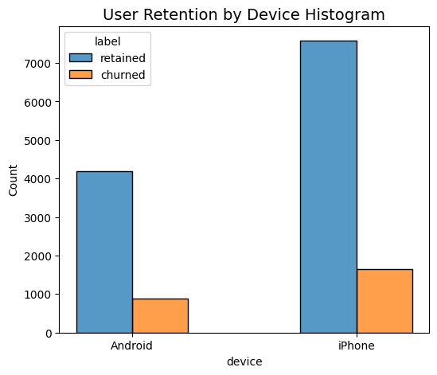
User Churn Project | Exploratory Data Analysis
Prepared for: Waze Leadership Team
Project Overview
The Waze data team is currently developing a data analytics project aimed at increasing overall growth by preventing monthly user churn on the Waze app. Thorough exploratory data analysis (EDA) enables Waze to make better decisions about how to proactively target users likely to churn, thereby improving retention and overall customer satisfaction. This report offers details and key insights from Exploratory Data Analysis, which impact the future development of the overall project.
The more times users used the app, the less likely they were to churn. While 40% of the users who didn't use the app at all last month churned, nobody who used the app 30 days churned.
Distance driven per driving day had a positive correlation with user churn. The farther a user drove on each driving day, the more likely they were to churn.
Number of driving days had a negative correlation with churn. Users who drove more days of the last month were less likely to churn.
Users of all tenures from brand new to ~10 years were relatively evenly represented in the data.
Nearly all the variables were either very right-skewed or uniformly distributed.
For the right-skewed distributions, this means that most users had values in the lower end of the range for that variable.
For the uniform distributions, this means that users were generally equally likely to have values anywhere within the range for that variable.
Several variables had highly improbable or perhaps even impossible outlying values, such as: driven_km_drives, activity_days and driving_days.
The churn rate is highest for people who didn't use Waze much during the last month.
The proportion of churned users to retained users is consistent between device types.
Investigate the erroneous or problematic discrepancies between number of sessions, driving_days, and activity_days.
Continue to explore user profiles with the greater Waze team; this may glean insights on the reason for the long distance drivers’ churn rate.
Plan to run deeper statistical analyses on the variables in the data to determine their impact on user churn.
Notes:
REVISED COPY

Slide 3
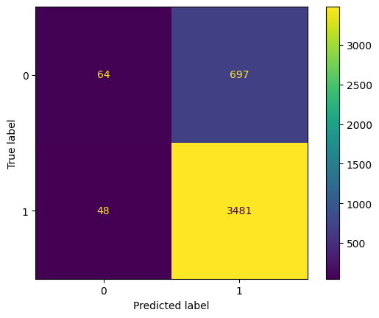
User Churn Project | Regression Modeling Results
Prepared for: Waze Leadership Team
The Waze data team is currently developing a data analytics project aimed at increasing overall growth by preventing monthly user churn on the Waze app. For the purposes of this project, churn quantifies the number of users who have uninstalled the Waze app or stopped using the app. Binomial logistic regression models typically offer flexibility and predictive power, which can be used to inform larger business decisions. Our team sought to build one from the data provided for this project. This report offers details and key insights from Regression Model, which impact the future development of the overall project.
Regression Modeling
🎯 Target Goal: Apply user data to build and analyze a binomial logistic regression model.
🎯 Methods:
Created features of interest to the stakeholders and business scenario
Assessed features for multicollinearity
Built the regression model
Evaluated model performance
🎯 Impact: With enough data, binomial logistic regression model results can reveal important variable relationships and predict binary outcomes, which can inform decisions for marketing and product development, for example.
Note: 1 = retained and 0 = churned
The efficacy of a binomial logistic regression model is determined by accuracy, precision, and recall scores; in particular, recall is essential to this model as it shows the number of churned users.
The model has mediocre precision (57% of its positive predictions are correct) but very low recall, with only 8% of churned users identified. This means the model makes a lot of false negative predictions and fails to capture users who will churn.
Activity Days emerged as the most influential predictor of user churn. It had a negative correlation with user churn.(reversed retention)
In previous EDA, user churn rate increased as the values in km_per_driving_day increased. In the model, distance driven per day was the second-least-important variable.
The current model should not be used for high-stakes business decisions or automated retention campaigns due to its poor recall performance.
The model can serve as a valuable tool for guiding further research and hypothesis generation about user behavior patterns.
It highlights the need for better features that correlate with churn and a clearer definition of Waze’s target user to effectively reduce monthly churn and drive growth.

